Slide 1
Soc Treasurer Training 2020
Jameson Thompson – 2020 Soc treasurer

Slide 2
‘club treasurer’ – general scope
Manage the finances of your club
Budgeting and financial planning
Banking
GRANTS

Slide 3
Background info
Guild Finance
  Open Mon-Fri 8:30am til 4:45pm
  Your CLUB ACCOUNT NUMBER is available in your BANKING BOOKS
  All enquiries can be sent to finance@guild.uwa.edu.au
Banking books
  Clubs have 2 banking books
    YELLOW → DEPOSITS
    PINK → WITHDRAWALS
  Books that are MISPLACED or NOT PASSED ONTO NEW EXEC’s → $20 charge for each new book

Slide 4
Executive registration form (ERF)
What is an ERF?
  A form containing the details and signatures of all current club executives
  This allows us to know who the executives of each club and society are
  Must be submitted to Guild Finance no later than 2 WEEKS AFTER THE AGM (or any change to a club’s exec)
  Guild Finance can only accept ORIGINAL HARD COPY of the ERF

Slide 5
Structure of Erf – 2 pages
Page 1
  For newly elected exec’s – allows Guild Finance to verify the details of exec’s and grant them access to the club’s accounts
Page 2
  Past Exec members – confirm the election of the current executives
  Returning Officers – ensure that the election/AGM is procedurally fair
NB – ERF should list at least TWO past executive members and
AT LEAST TWO Returning Officers

Slide 6
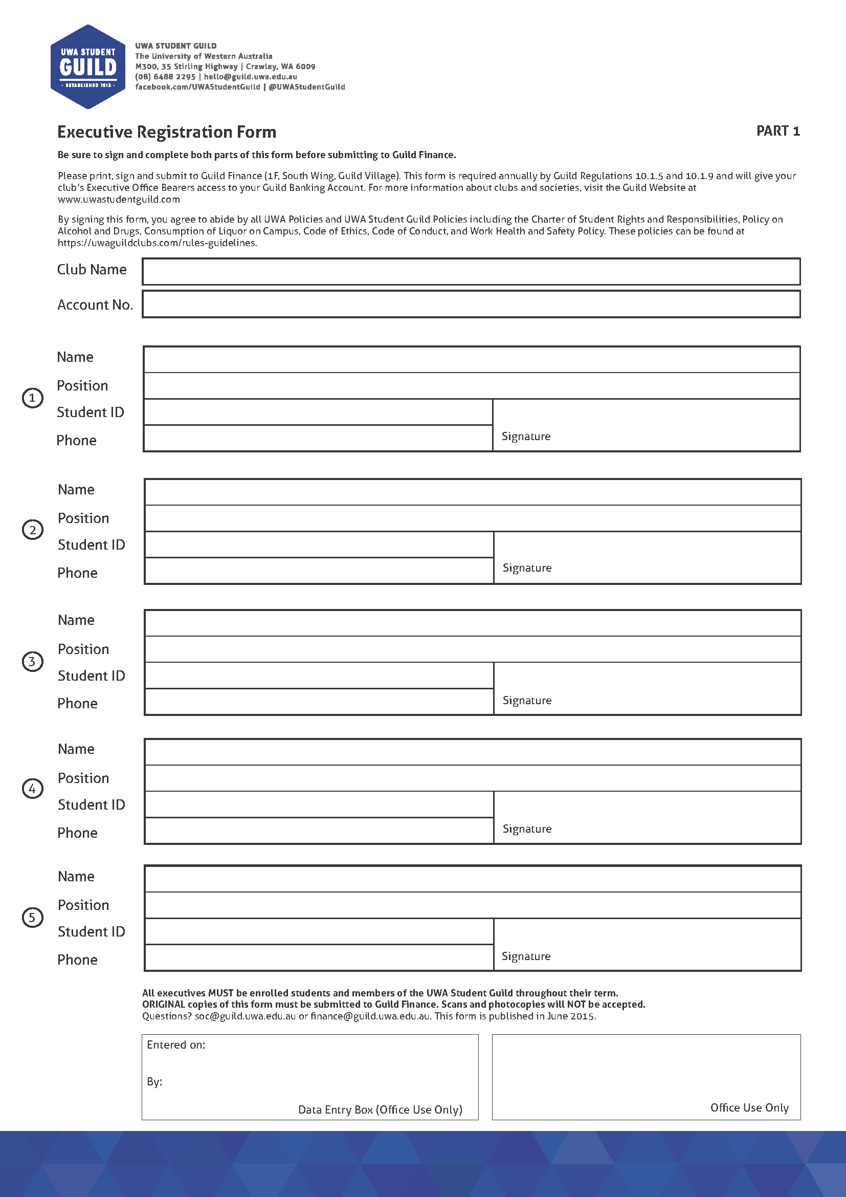
ERF – example

Slide 7
ERF Example – Cont’d

Slide 8
Returning officers (RO’s)
RO’s must NOT:
  have been on the club’s committee in the last year
  currently be on the club’s committee
  run in the same election in which they are an RO
RO’s can:
  Be a Guild staff member
  Be a UWA staff member
  Be a previous committee member from more than a year ago
  Be a financial member of the club

Slide 9
Netsuite
What is it?
  Netsuite is an online platform that allows all clubs to view their financial statements
  Statements can be generated in Excel or PDF
How do I use it?
  Click ‘see all transactions’ (under Billing) to view your current statement
  Click the hyperlinked date to view full details of each individual deposit and withdrawal
  NB – ‘Deposit Action’ refers to Club withdrawals

Slide 10
Netsuite – example
Billing
See All Transactions

Slide 11
Club banking
Withdrawals (PINK SLIPS)
  Requirements for a valid withdrawal:
    Authorised by at least 2 EXEC MEMBERS (name, signature, position)
    Signatures must match ERF
    Payee is a person OR external entity
    The payee CANNOT be one of the 2 exec members authorising the withdrawal
    Payee on withdrawal slip for CASH is the person picking up the money
    MUST BE DATED

Slide 12
Club banking cont’d
How do I make a withdrawal from my club’s Guild Account?
  Cash
    Any amount
  Bank transfer
    Minimum of $50 per bank transfer withdrawal
    State BSB, account number, and account name in payee column
    NB bank transfers are carried out EVERY THURSDAY – if payment is urgent, you must make the Finance Department aware of this

Slide 13
Club banking cont’d
Deposits (YELLOW SLIPS)
  Cash
    Count your cash prior to depositing!
  Debit/Credit Card
    Present your card to Guild Finance
  Bank Transfer
    Email finance@guild.uwa.edu.au to provide details for transfer (club name, account number, transfer amount, etc)
Floats
  Email finance@guild.uwa.edu.au stating the denominations needed and the total amount
  Please give AT LEAST 24 HOURS NOTICE

Slide 14
Club banking – cont’d
Interest
  Clubs with a minimum of $3000 in their bank account will earn interest over the semester
  Interest is calculated in January of the following year upon receiving confirmation of interest rates from UWA
    Assuming ending balance is >$3000, the amount used for calculation will be the balance on the last day of the month
Payment of invoices
  Internal
    Entities that operate within UWA (ie. Guild Catering, Tavern, Guild Venue Hires)
  External
    Any person/entity that operates outside of UWA and the Guild
Printing
  Printing vouchers for CCZ can be purchased from Guild Finance ($5, $10, and $20)
  Funds can be transferred to a club’s prepaid Uniprint account by making a withdrawal payable to ‘Uniprint’

Slide 15
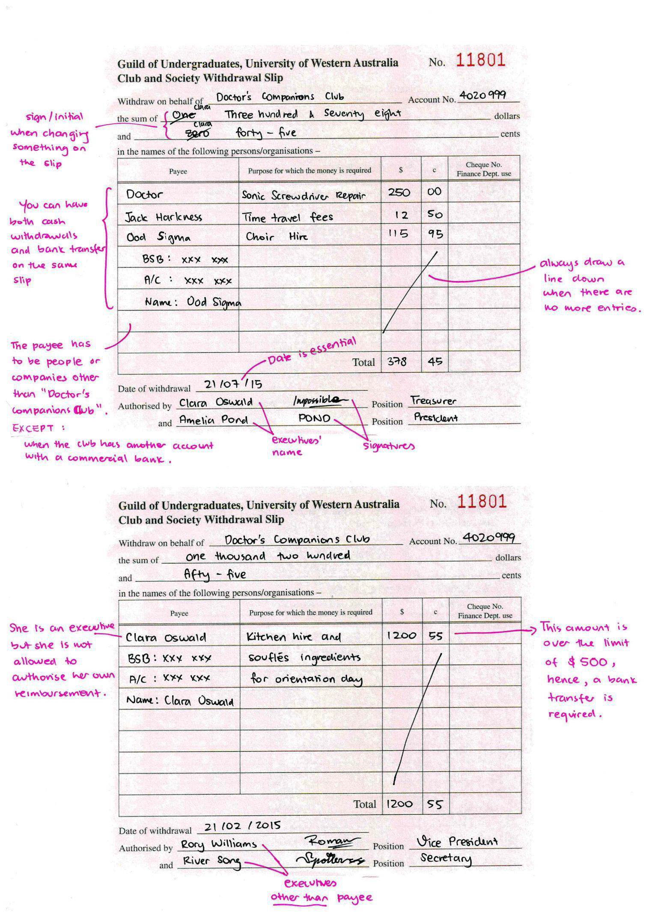
Withdrawal slip example 1

Slide 16
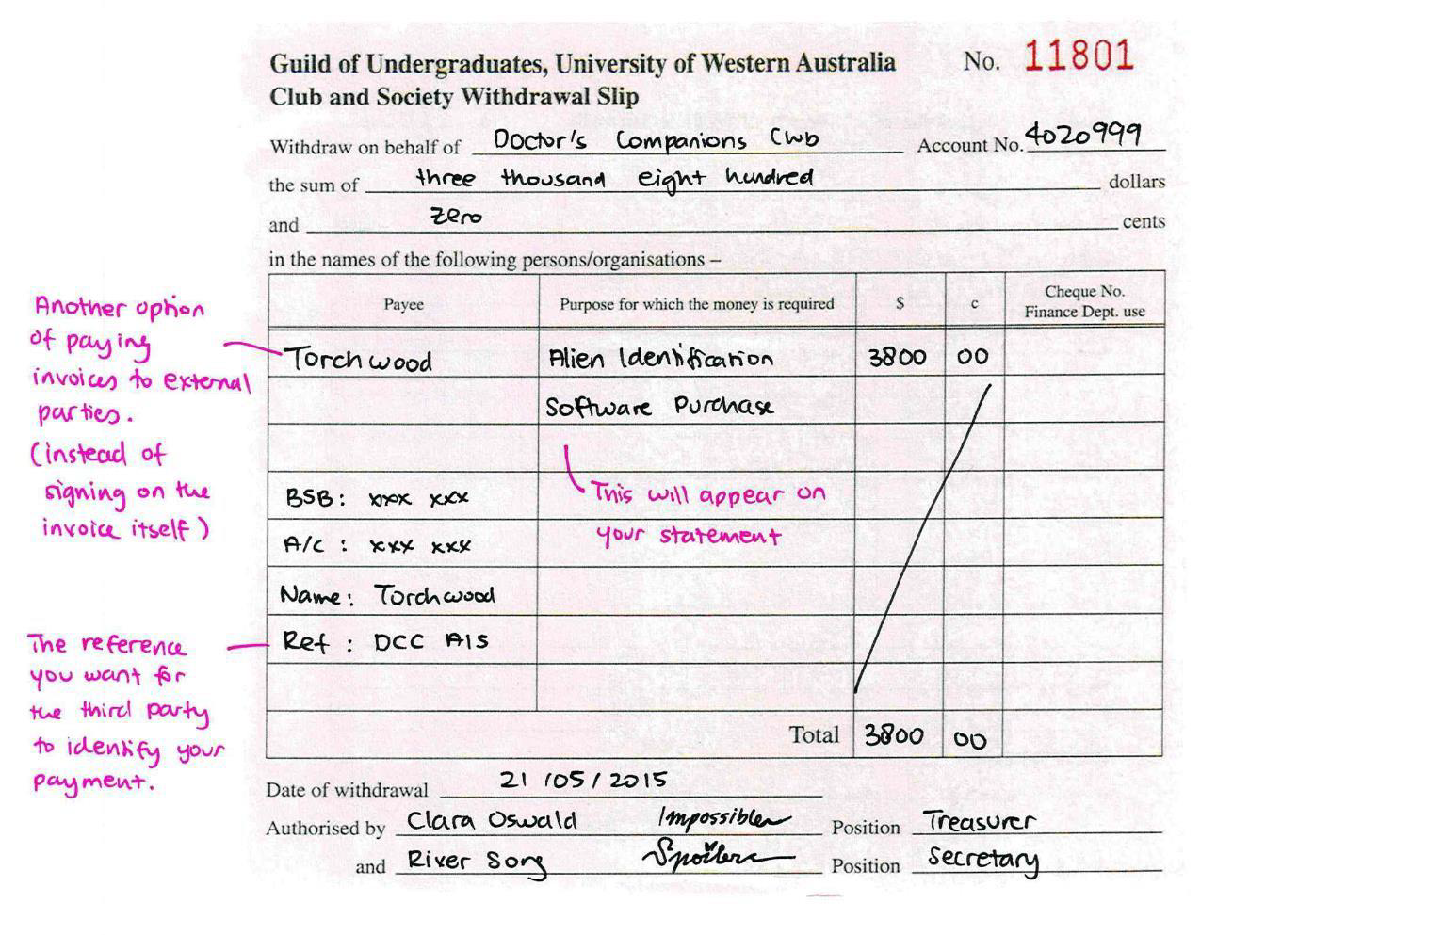
Withdrawal slip example 2

Slide 17
Deposit slip – example 1

Slide 18
Grants
3 main types of Grants
  O-Day Grant
  Special Project Grants
  Semester Grants
Please see the UWA Student Guild Club Grants Policy for grant regulations
See articles 52-60 of the UWA Student Guild Club Grants Policy for the factors taken into consideration by SOC in the review of Grant applications

Slide 19
Treasurer tips
Read your constitution!
Stay organised
  Keep on top of emails, expenditure, budgeting, archiving documents (ie. Receipts, etc.)
The best sources of club income are profitable events/services, and applying for sponsorship
Apply for prizes (ie. Most inclusive event, best club, best new club)
When collaborating with other clubs, ensure that there is a written agreement as to how expenditure is to be split/profits are to be distributed

Slide 20
O-Day grants
When is the O-Day Grant due?
  Email your grant application to the SOC Treasurer by the due date
  (11:59pm 26th March 2020)
How much can I get reimbursed?
  There will be a prescribed limit that clubs can claim which is hinged on:
    The funds available for O-Day Grants, and;
    The cost of hiring an O-Day stall without a marquee from the Guild
How will I know how much money I’ve been reimbursed?
  The SOC Treasurer will publicise O-Day Grant applications after they have been reviewed by the Grants Subcommittee

Slide 21
Special project grants (SPG’s)
When is the Special Project Grant application due?
  2 due dates
    Semester 1 – 11:59pm 30th April 2020
    Semester 2 – 11:59pm 6th August 2020
What does this grant cover?
  SPG’s are used to fund Club events/activities/purchases that pose significant benefit to Club members and the promotion of its objects by means of supplementary financial support
How do I submit an SPG application?
  Complete relevant forms found on the Guild website and submit applications by email to the SOC Treasurer
  The SOC Treasurer will inform Guild finance of successful applications to ensure that the funds are distributed ASAP

Slide 22
Special project grants (SPg’s) – cont’d
How much can I claim?
  Up to $1000 can be claimed each year
  This means you can claim $400 in Semester 1 and $600 in Semester 2, the entire $1000 in Semester 1 or 2, or any other division of $1000 over the two semesters
What happens after the SPG application has been approved?
  The club must submit a final expenditure statement with receipts to the SOC Treasurer when the grant funds have been utilised
    If the SOC Committee is not satisfied the grant funds have been utilised in the manner prescribed in the application, they may require that the Club in question return a specified portion of the funding to the Guild

Slide 23


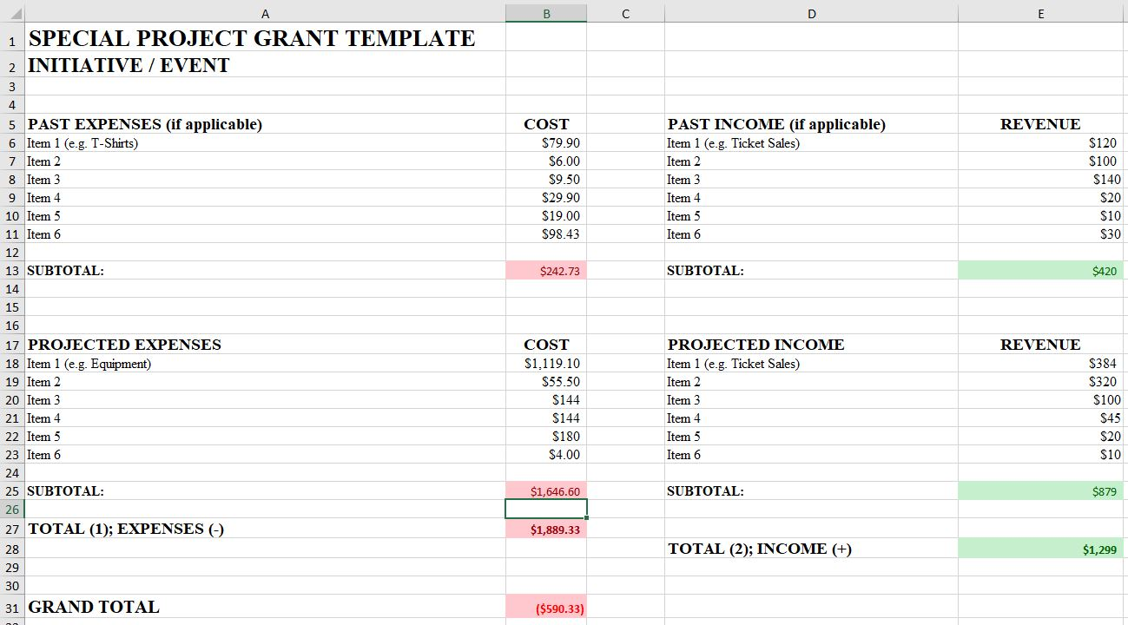

Slide 24
Semester Grant
When is this grant application due?
  2 due dates
    Semester 1 – 11:59pm 21st May 2020
    Semester 2 – 11:59pm 22nd October 2020
What can be claimed with this grant?
  The semester grant gives clubs the opportunity to be reimbursed for expenses incurred throughout the semester
What cannot be claimed with this grant?
  Clubs cannot claim expenses incurred for the purpose of events/activities funded by SPG’s or Lion Nathan Grants
  Clubs can only claim expenses incurred for the purpose of O-Day where they can prove such expenses have a continuing benefit for Club members (eg. Club t-shirts)

Slide 25
Semester grant – cont’d
Penalties affecting Semester 1 and 2 grants
Issue | Penalty
Failure to send a delegate to any SOC Meetings throughout the year | Lapsing (not eligible for SOC grants/benefits)
Failure to send a delegate to 3 or more SOC Meetings throughout the year | 40% cut in semester grants for the year
Failure to send a delegate to 2 SOC Meetings throughout the year | 25% cut in semester grants for the year
Failure to send a delegate to 1 SOC Meeting throughout the year | 15% cut in semester grants for the year
Failure to attend Treasurer Training | 40% cut in semester grants for the year
NB – the above penalties do not apply to Clubs who send apologies at least 24 hours prior to the relevant SOC Meeting with a reasonable explanation for the inattendance

